Slide 1

Application Migration to AWS Automation in AWS
AWS conference 29.1.2019
Petros Georgiadis
AWS Architect / Developer
Tieto, Application Services
petros.georgiadis@tieto.com

Slide 2

Agenda
About Tieto
AWS value proposition
Cloud migration strategies
Elastic Container Service
Automation in AWS (Demo)
Customer Story
Lessons learnt
Next steps
About Tieto
AWS value proposition
Cloud migration strategies
Customer story – real live experience
AWS Elastic Container Service (+ demo)
Lessons learnt

Slide 3


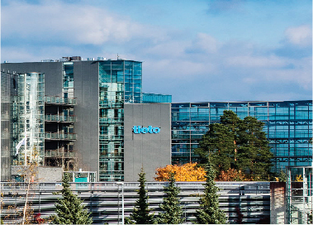







50 years of Tieto Nordic IT provider and Service Integrator
1968
1990-2000
2016
Tietotehdas founded in Helsinki
IT boom & acquisitions, mergers and alliances lead to rapid growth
Tieto launches new strategy to accelerate innovation and growth
1978
2012
First energy efficiency project with Swedish data center
Tieto introduces Cloud Server, the fastest and most flexible cloud service in the market
1970-1980
1999
2016
Customer base grows to represent several industries
TietoEnator founded and later becomes Tieto Corporation
#AliciaT appointed to the leadership team
2014
1984
Tieto’s first start-ups, CEM and Industrial Internet, established
Tietotehdas stock-listed on ASDAQ OMX in Helsinki

Slide 4
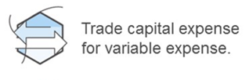
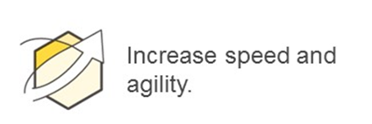
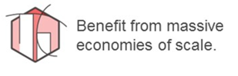
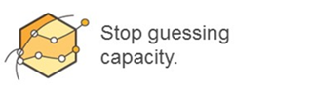
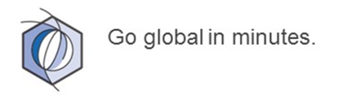
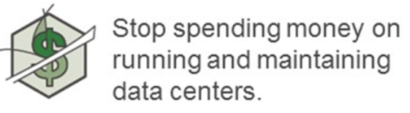
AWS value proposition
TCO Reductions
Time to Market
Automation
App. Modernization - Elasticity and Fault-Tolerance
Security (https://aws.amazon.com/compliance/programs/)
Notes:
Story about the origins of AWS cloud

Slide 5
AWS value proposition In my own words…
AWS makes complicated things simple…
&
Affordable…
Notes:
Story about the origins of AWS cloud

Slide 6
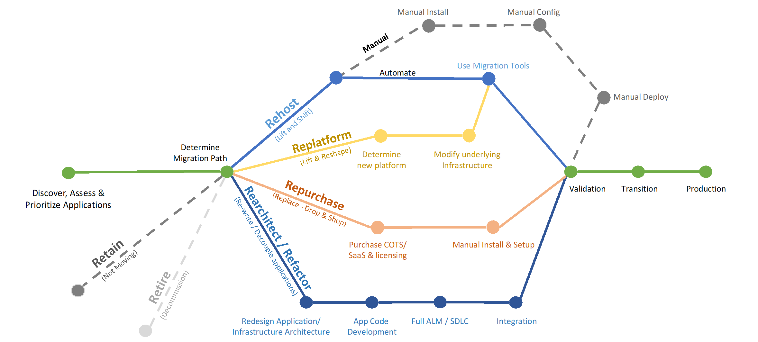
AWS Migration Methodology – 6 R’s
Understand the Digital strategy
Source: https://aws.amazon.com/blogs/enterprise-strategy/6-strategies-for-migrating-applications-to-the-cloud/

Slide 7
Migrations to Cloud - summary
Re-hosting - Lift & Shift migration:
Copy/paste as is
Re-platforming - using Automation & Cloud Managed services:
Creating automation, splitting the components, changing OS
Using AWS PaaS services (AWS Elastic Beanstalk, RDS, etc.)
Customer gets scalability and certain level of fault tolerance
Doesn't require major changes of the application source code
Re-factoring - re-design the application:
Building solutions that “never” fail - full recovery from failures (micro-services, message queues), highly optimized infra use, replacing rational DBs with NoSQL for scalability reasons, etc.
Serverless computing – building entire solutions on top of Cloud PaaS without commissioning any virtual servers
Re-purchase – buying the app. as SaaS

Slide 8
Application Modernization Flow
Cost Reduction
(License Renewal, System Refresh, Operational Efficiencies)
Risk Reduction
(Regulatory Requirements, EoL H/W, Unsupported Applications, Audit Compliance)
Business Transformation
(Business Expansion, Increased Innovation & Agility, Reduced Time to Market)
Continuous Improvement
Customer Value Drivers
Readiness, Discovery & Assessment
Current Estate Analysis
Landscape Discovery
Inventory Data Analysis
Application Arch. Assessment
Security Assessment
Risk & Compliance Assessment
Business Case
Technical & Business Complexity Scorecard
No
Retain
Retire
Migration Candidates
Key Determinants
Time Available to Migrate?
>6 months
Fixed Deadline for delivery?
No
>50k
Is Application about to End-of-Life?
No
Size Available for Investment?
New Services
<6 months
Yes
<50k
Yes
Migration Pattern
Re-Host
Re-Platform
Re-Purchase
Re-Architect/ Re-Factor
Continuous Services & Modernization
Application Optimization
Process Optimization
Operational Optimization
Cost Optimization
Serverless
Cloud as Operating System
CI/CD as a service
Qualitative, Predictive & Pro-active analytics
AI, ML, IoT, Mobile

Slide 9

Elastic Container Service
Docker container management system

Slide 10
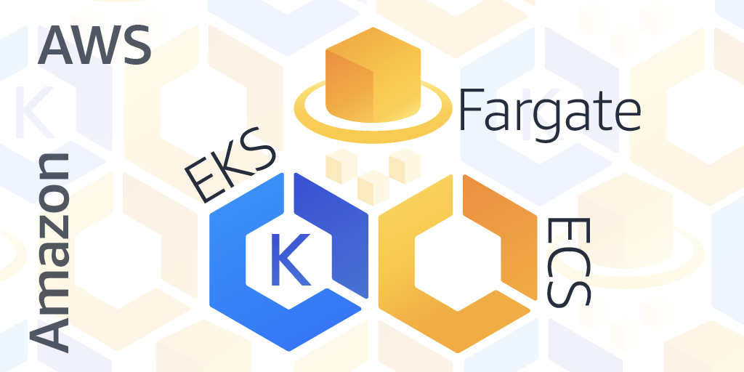
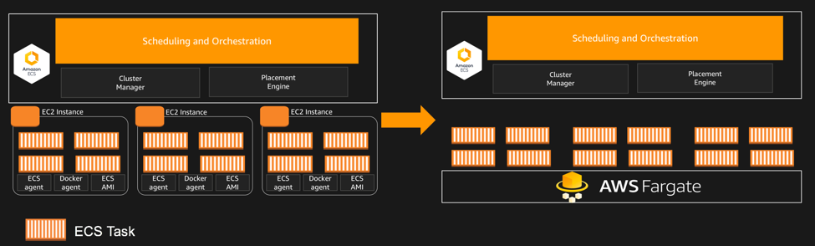

Slide 11

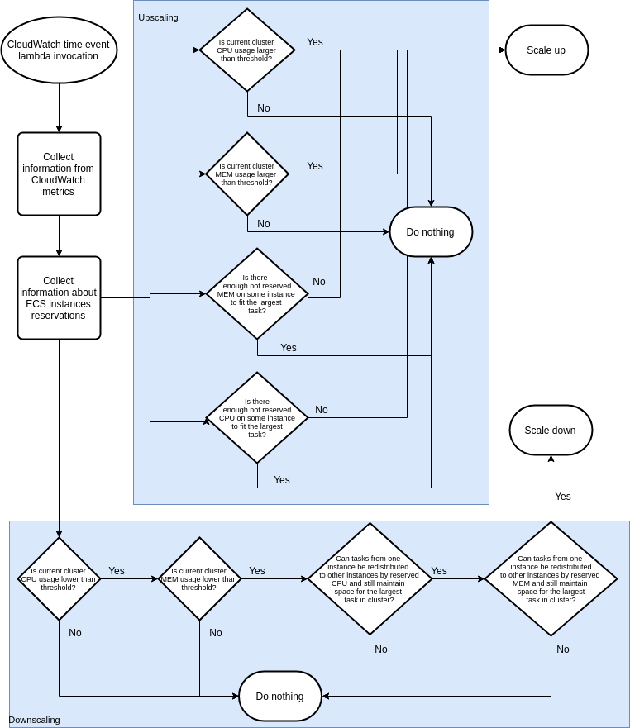
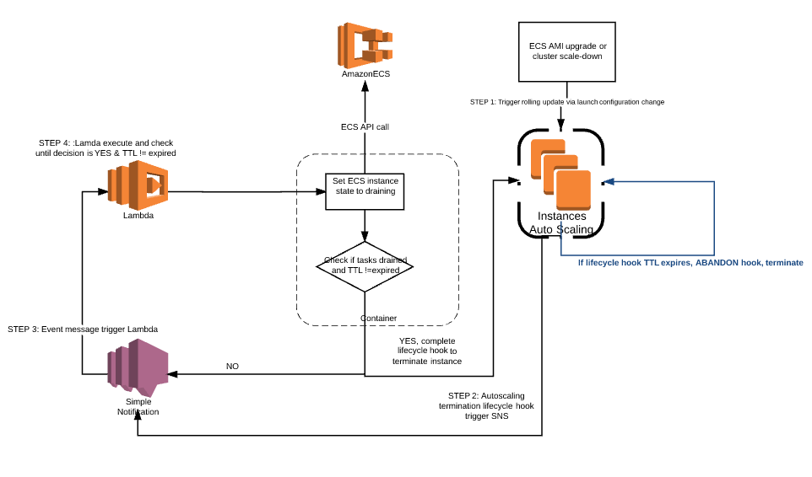
ECS EC2 cluster - Automation
0 downtime cluster rebuild
https://aws.amazon.com/blogs/compute/how-to-automate-container-instance-draining-in-amazon-ecs/
EC2 Cluster Autoscaling
Since 7. 1. 2019

Slide 12

Announcing AWS Fargate Price Reduction By Up To 50%
(https://aws.amazon.com/about-aws/whats-new/2019/01/announcing-aws-fargate-price-reduction-by-up-to-50-/)
“Effective Jan 07, 2019, we are reducing the price for AWS Fargate by 20% for vCPU and 65% for memory across all regions where Fargate is currently available.”
Supported Configurations
CPU | Memory Values
0.25 vCPU | 0.5GB, 1GB, and 2GB
0.5 vCPU | Min. 1GB and Max. 4GB, in 1GB increments
1 vCPU | Min. 2GB and Max. 8GB, in 1GB increments
2 vCPU | Min. 4GB and Max. 16GB, in 1GB increments
4 vCPU | Min. 8GB and Max. 30GB, in 1GB increments
Region:
EU (Ireland) | Price
per vCPU per hour | $0.04048
per GB per hour | $0.004445

Slide 13

Automation in AWS

Slide 14
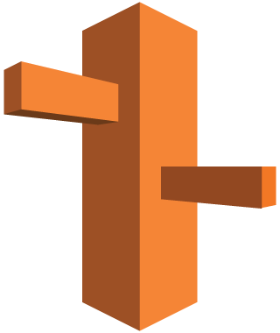
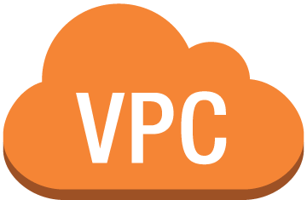

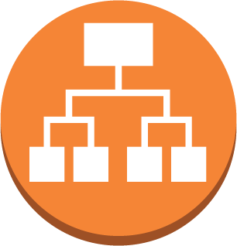


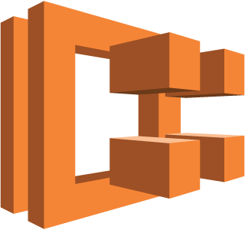


Demo scope
demo-service*.tietoaws.com
Amazon Route 53
Infra as Code (Terraform)
AWS:
VPC, Subnets, Security Groups
ECS Fargate cluster
Application LoadBalancer
ECS task(s) + autoscaling
Route53 DNS records
CloudWatch Dashboards/Alarms
On-demand environment
security group ALB
Application Load Balancer
Amazon CloudWatch
Public subnets
Terraform code available in:
https://github.com/georgpet/ecs_fargate_demo
Amazon ECS Fargate
ECS tasks (containers)
security group ECS
event-based task scaling
Private subnets
Availability Zone 1
Availability Zone 2
Availability Zone 3

Slide 15

Customer story
Nordic Telecom Operator
Application Development & Management services

Slide 16
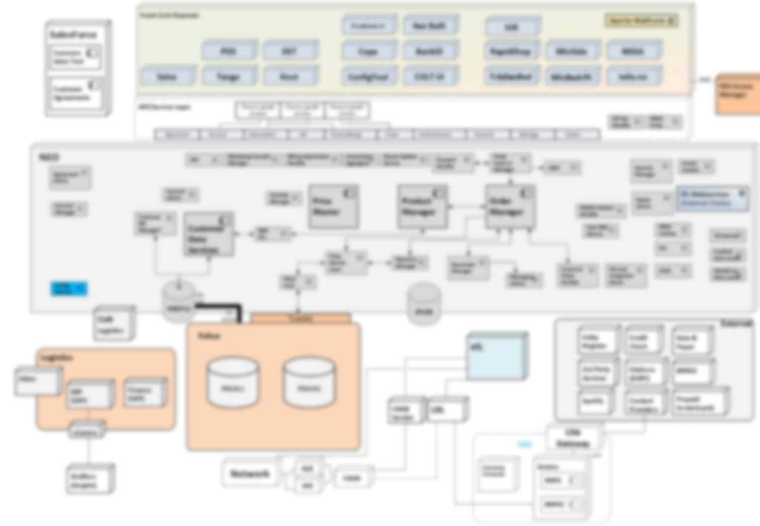
Business support system diagram
Channels
Order mngmt. &
Integrations
External
systems
Billing
Notes:
How did it look like ?

Slide 17
Integration layer cloudification Tieto is responsible for moving order management and orchestration components to AWS
Tieto has been performing migration of integration layer to AWS:
Analysis and mapping on-premise architecture to Amazon AWS building blocks
Planning, design, migration and testing of order management service components to cloud environment
Implementation of infrastructure as Code using Terraform
Enhancing continuous delivery practices by creating cloud deployment pipeline, Docker containerization and automation
Moving from on-premise infrastructure to AWS involves:
40+ service components
1400+ JVM instances
~10 Oracle databases
10+ channels connected
10+ external services and sources
5+ core backend systems
Customer benefits:
Increased scalability, reliability and availability of service components in testing, staging and production environments
Better productivity of DevOps teams by automated deployments to cloud
Full history of infrastructure evolvement with faster rollbacks reducing downtimes in maintenance and operations
Reducing maintenance operational cost and removing manual configuration tasks with automated infrastructure

Slide 18
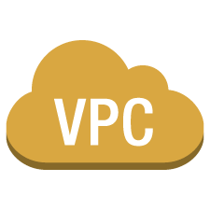
High Level Architecture
On premise
AWS
Component
App. Services
Other Products
Component
ALB, ECS, Route53
App. components deployed to ECS
Database service RDS
Component
Component
Application server (EC2)
Database service RDS
DB
DB
Dedicated AWS account
Dedicated AWS account
peering
Load Balancer (F5)
Firewall
Direct Connect
direct-connect-vpc
HaProxy (reverse proxy)
VPN
(backup)
EU (Ireland)
Dedicated AWS account
18

Slide 19



Everything as a Code
Applying standard SW code development lifecycle process
AWS
Dev
Stage
Prod
System Test
Code reviews
Merge to master triggers CI/CD
AT
Prod
19
Notes:
Concourse by Pivotal

Slide 20
Lessons learnt
Have a support from the management and proper prioritization
Do it right from the beginning – e.g. account structure, automation
Invest into your teams knowledge
Have cost optimization as priority #1

Slide 21
Next steps…
Migrate from ECS EC2 cluster to ECS Fargate
Optimize AWS usage:
Container right sizing in terms of CPU & Memory
Implement autoscaling on task level
Migrate from Oracle to PosgreSQL
CloudWatch logs optimizations
OnDemand environment – e.g. test automation after every build
Redesign the solution to utilize additional AWS services, e.g.:
AWS Lambda
AWS Batch
S3
DynamoDB
AWS ElastiCache

Slide 22
Petros Georgiadis
AWS Architect / Developer
Tieto / Application Services
petros.georgiadis@tieto.com

